Slide 1
Enhancing Language Generation with Knowledge Graphs
Meng Jiang
University of Notre Dame

Slide 2
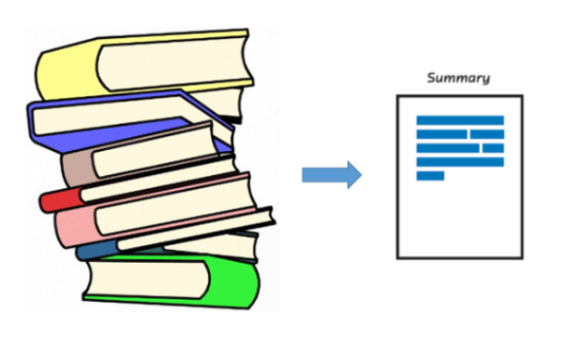






Input $X$
Machine Translation
Abstractive Summarization
Language Generation Model
$$p_{θ}(Y|X)$$
Output $Y$
Question Answering
Commonsense Reasoning

Slide 3
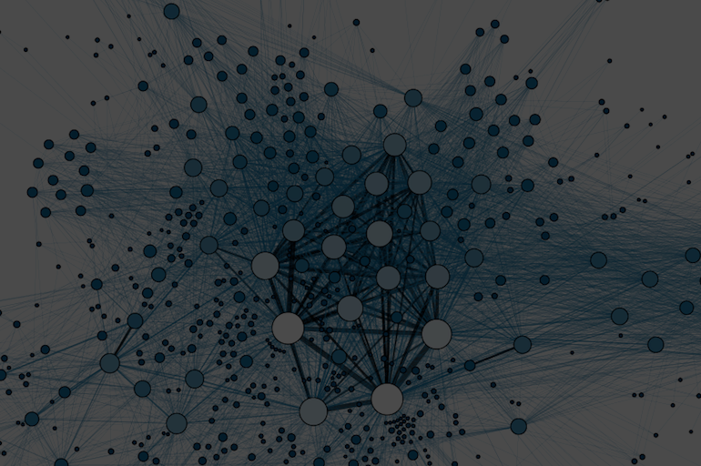
What is Knowledge Graph?
A graph is a conceptual representation of a group of things — called nodes
— and the relationships between them — called edges.
A graph of general/specialized knowledge is constructed from a collection of databases in general/specialized domains.
It encodes relationships uncovered by billions of humans over thousands of years into a single resource.

Slide 4
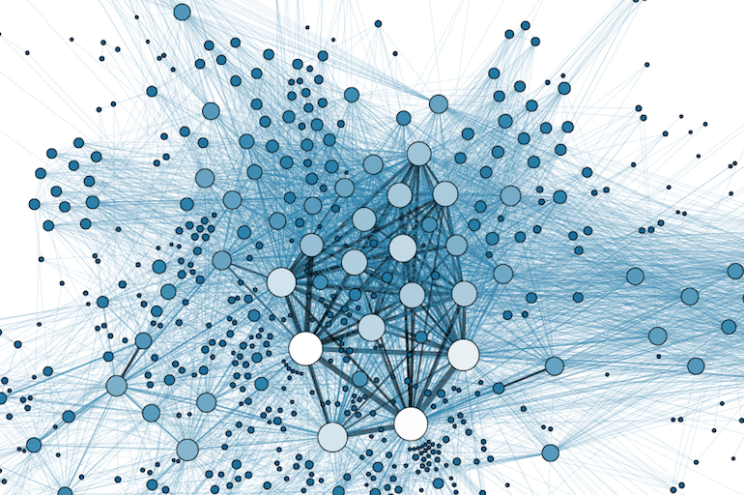
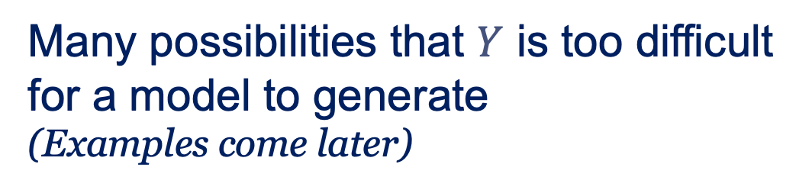


Knowledge Graph $G$
Input $X$
Language Generation Model
$$p_{θ}(Y|X)$$
Enhance the model
$$p_{θ}(Y|X,G)$$
Output $Y$
Many possibilities that $Y$ is too difficult for a model to generate
(Examples come later)

Slide 5





When are the Knowledge Graphs useful?
When $Y$ is too difficult for a model to generate, given only $X$ …

Slide 6
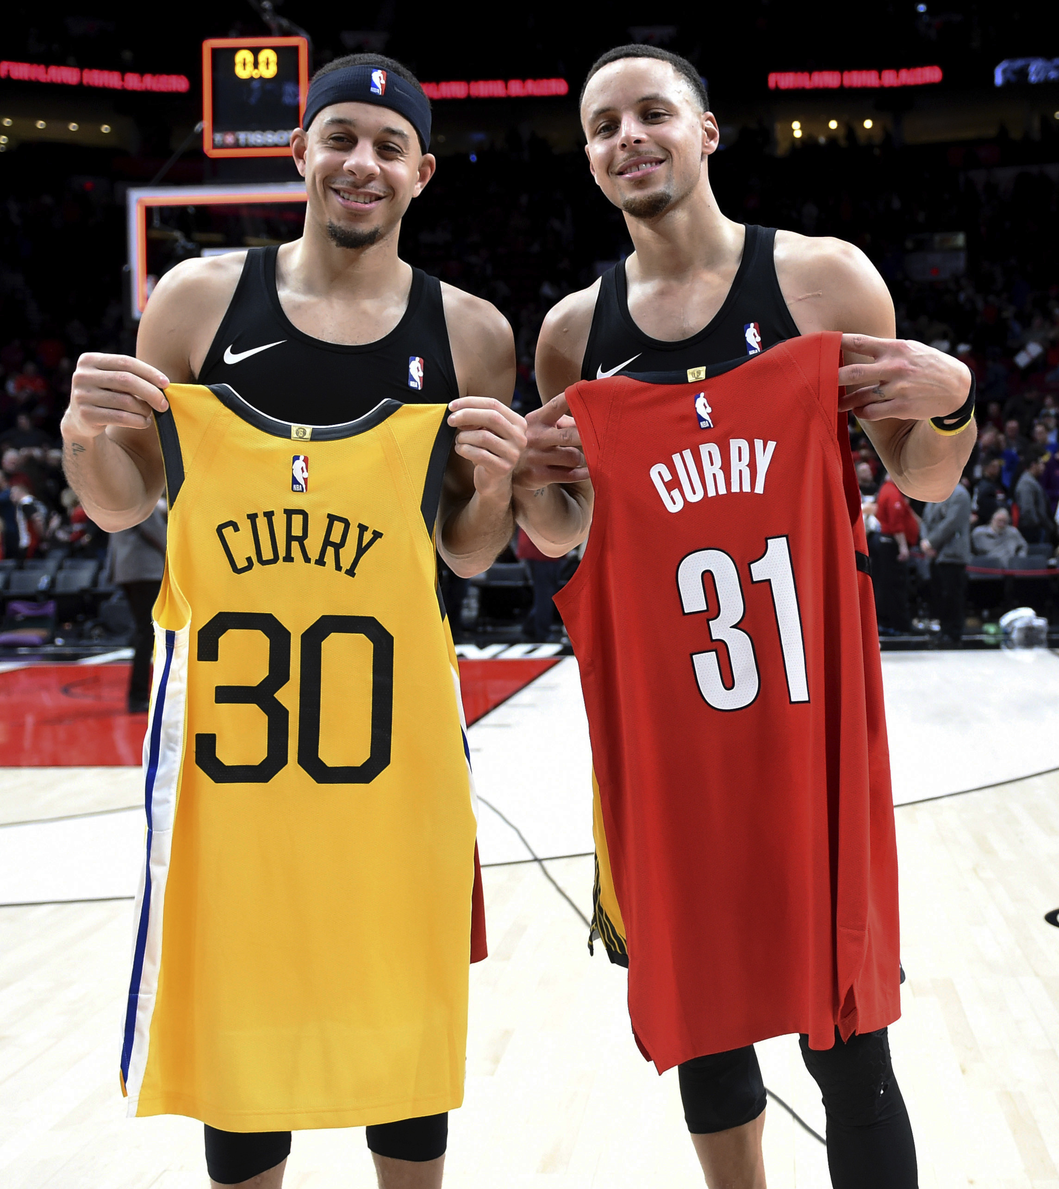
Machine Translation
English to Chinese
Input:
After Seth Curry tallied 24 points for the 76ers in game six against the Hawks, his brother Steph chimed in on social media with a reaction.
Chinese vocabulary:
兄弟 brothers/cousins; blood or sworn brothers/best friends; gang members
哥哥 elder brother
弟弟 younger brother
In Chinese, the expression of “brother” relationship is often specified to 哥哥/弟弟.

Slide 7
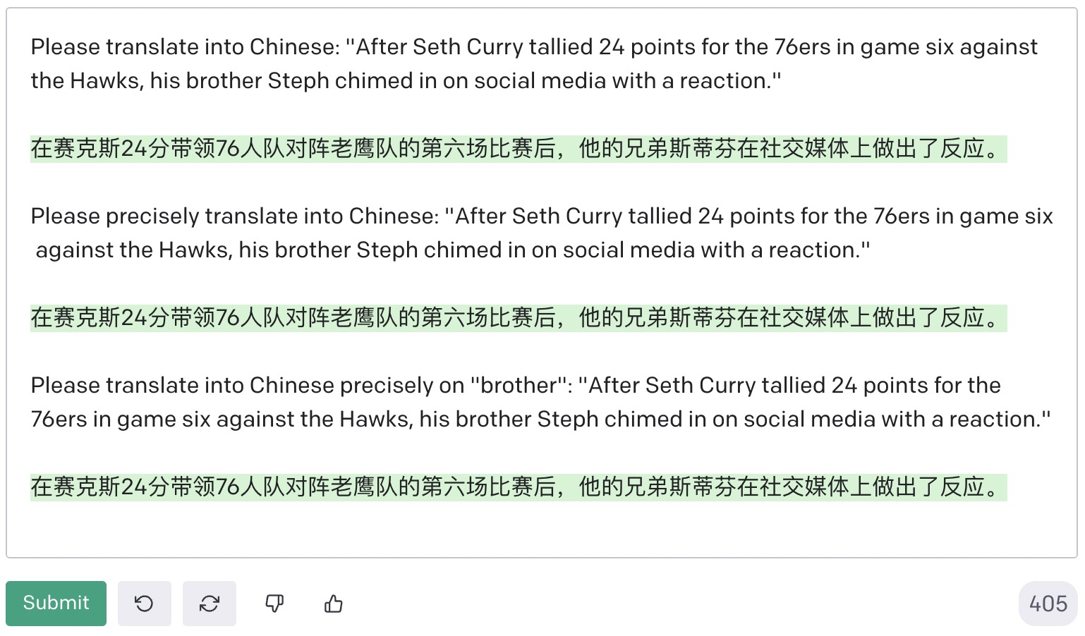
GPT-3

Slide 8
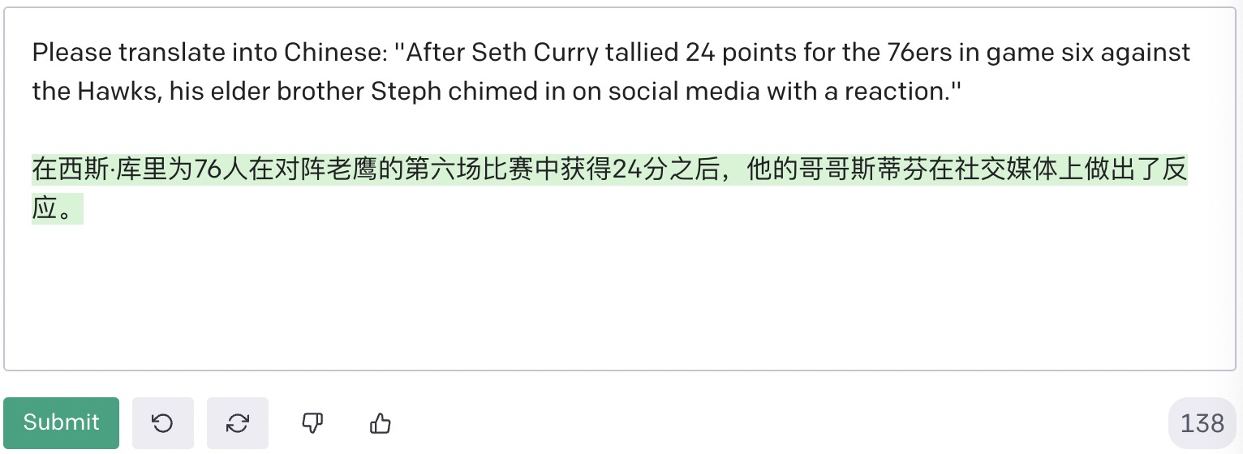
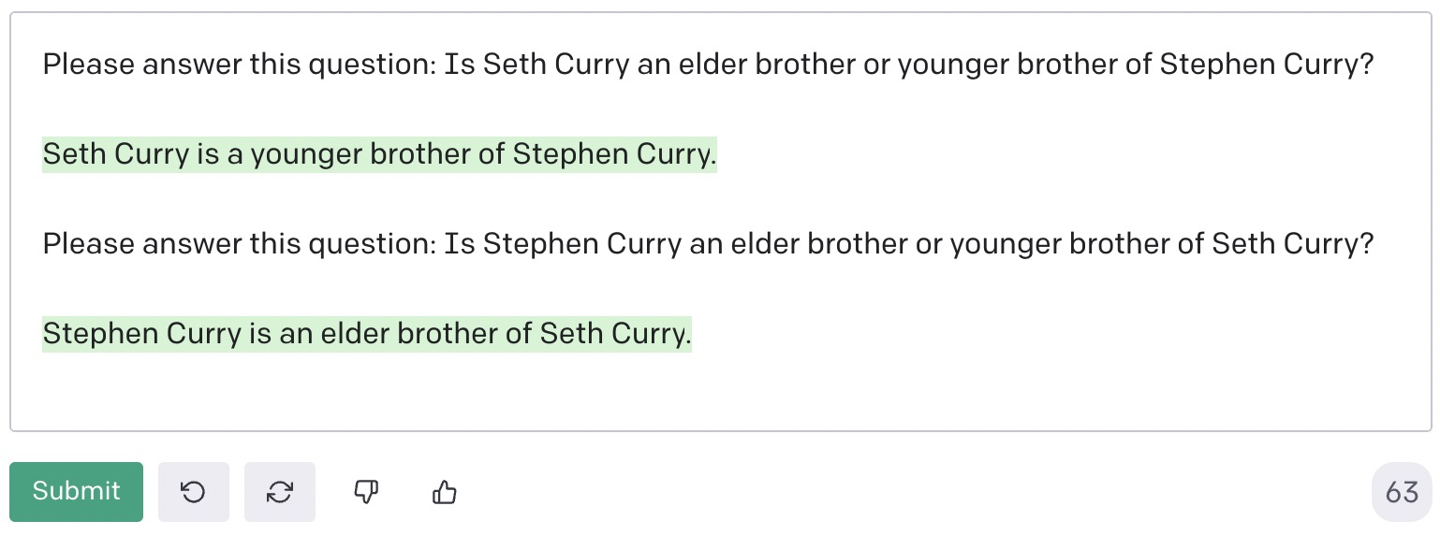
When “elder” or “younger” specified …
Does GPT-3 know the fact?

Slide 9
Enhancing Translation Precision
When knowledge was represented as billions of parameters in language models, one could hardly guarantee that there would be a general, effective method that can use the knowledge to generate precise language.
Solution: Roll back to where the knowledge was obtained to train the model. Enhance the model explicitly with data.

Slide 10
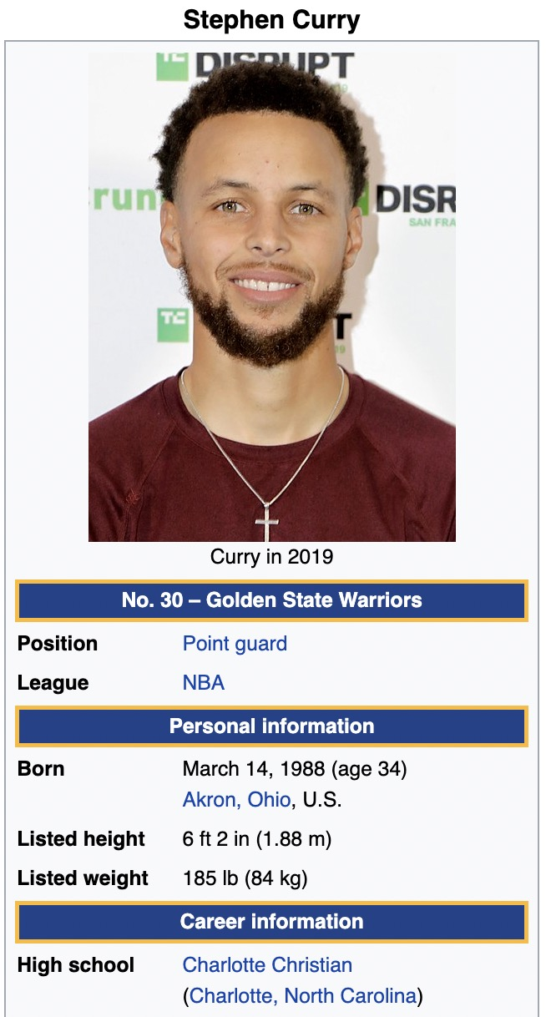
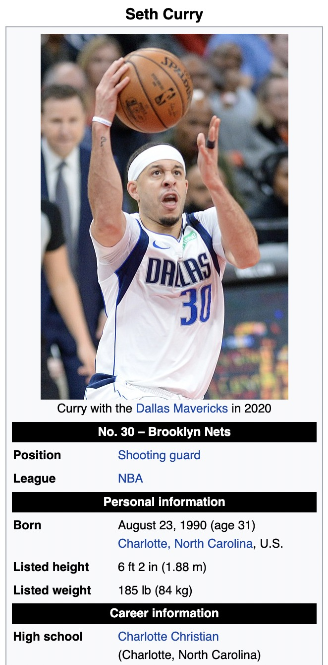

Steph Curry
03/14/1988
Seth Curry
08/23/1990

Slide 11

Retrieval-Augmented NMT
Input $X$:
(retrieval)
After Seth Curry tallied 24 points for the 76ers in game six against the Hawks, his brother Steph chimed in on social media with a reaction.
(encoding)
(entity linking)
(augmentation)
(decoding)
…他的哥哥斯蒂芬…
Please stay tuned on our results …
(acks to NSF IIS-2137396)

Slide 12
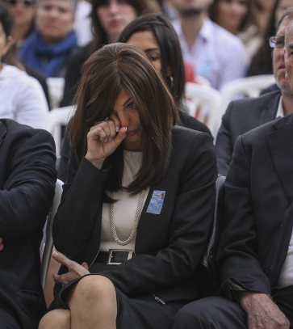
Abstractive Summarization
Factual correctness matters!
Input:
… Her husband was one of 17 people killed in January’s terror attacks in Paris …
… Valerie Braham said to the assembled crowd …
Possible outputs:
“Philippe Braham said to the crowd …”
“Paris was killed in the January’s terror attacks …”
“Valerie Braham was killed in the January’s terror attacks …”

Slide 13
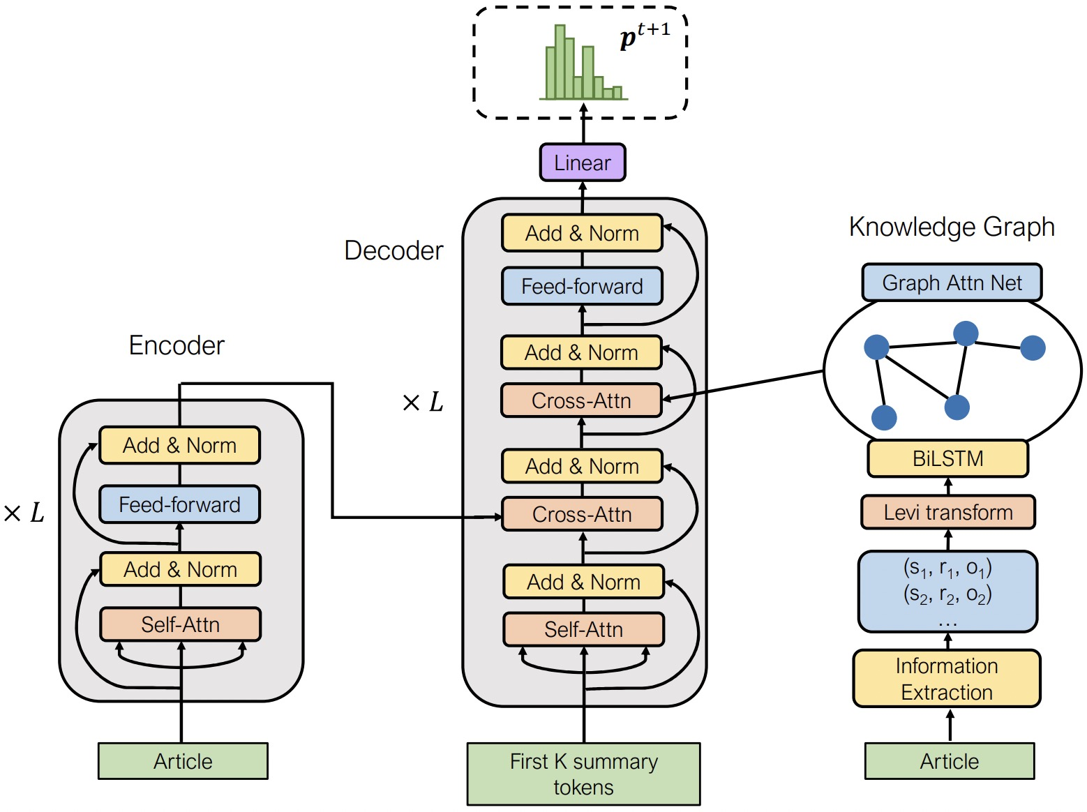


FASum: Fact-Aware Summarizer
Output $Y$
Fact corrector
$$G$$
Knowledge representation with GNN (GAT)
Knowledge extraction
with OpenIE
Input $X$
Zhu, Hinthorn, Xu, Zeng, Zeng, Huang, Jiang. “Enhancing Factual Consistency of Abstractive Summarization.” In NAACL, pp. 718-733. 2021.

Slide 14

Results: XSum
 | Fact Score* | R-1 | R-2 | R-L
BottomUp | 78.0 | 26.91 | 7.66 | 20.01
Seq2Seq | 80.6 | 31.44 | 10.91 | 24.69
UniLM | 83.2 | 42.14 | 19.53 | 34.13
FASum | 83.4 | 42.18 | 19.53 | 34.15
*To evaluate factual consistency, we re-implemented and trained FactCC (Kryscinski et al., 2019). The model outputs a Fact Score between 0 and 1, where a higher score indicates better consistency between the input article and summary. The training of FactCC is independent of our summarizer so no parameters are shared.

Slide 15


Results: CNN/DailyMail
 | Fact Score | R-1 | R-2 | R-L
BottomUp | 83.9 | 41.22 | 18.68 | 38.34
Seq2Seq | 85.0 | 41.03 | 18.04 | 37.93
UniLM | 87.2 | 43.33 | 40.21 | 40.51
FASum | 88.1 | 40.53 | 17.84 | 37.40
Human evaluation:
 | Factual Score | Informativeness
BottomUp | 2.32 | 2.23
Seq2Seq | 2.59 | 2.30
UniLM | 2.65 | 2.45
FASum | 2.74 | 2.42

Slide 16
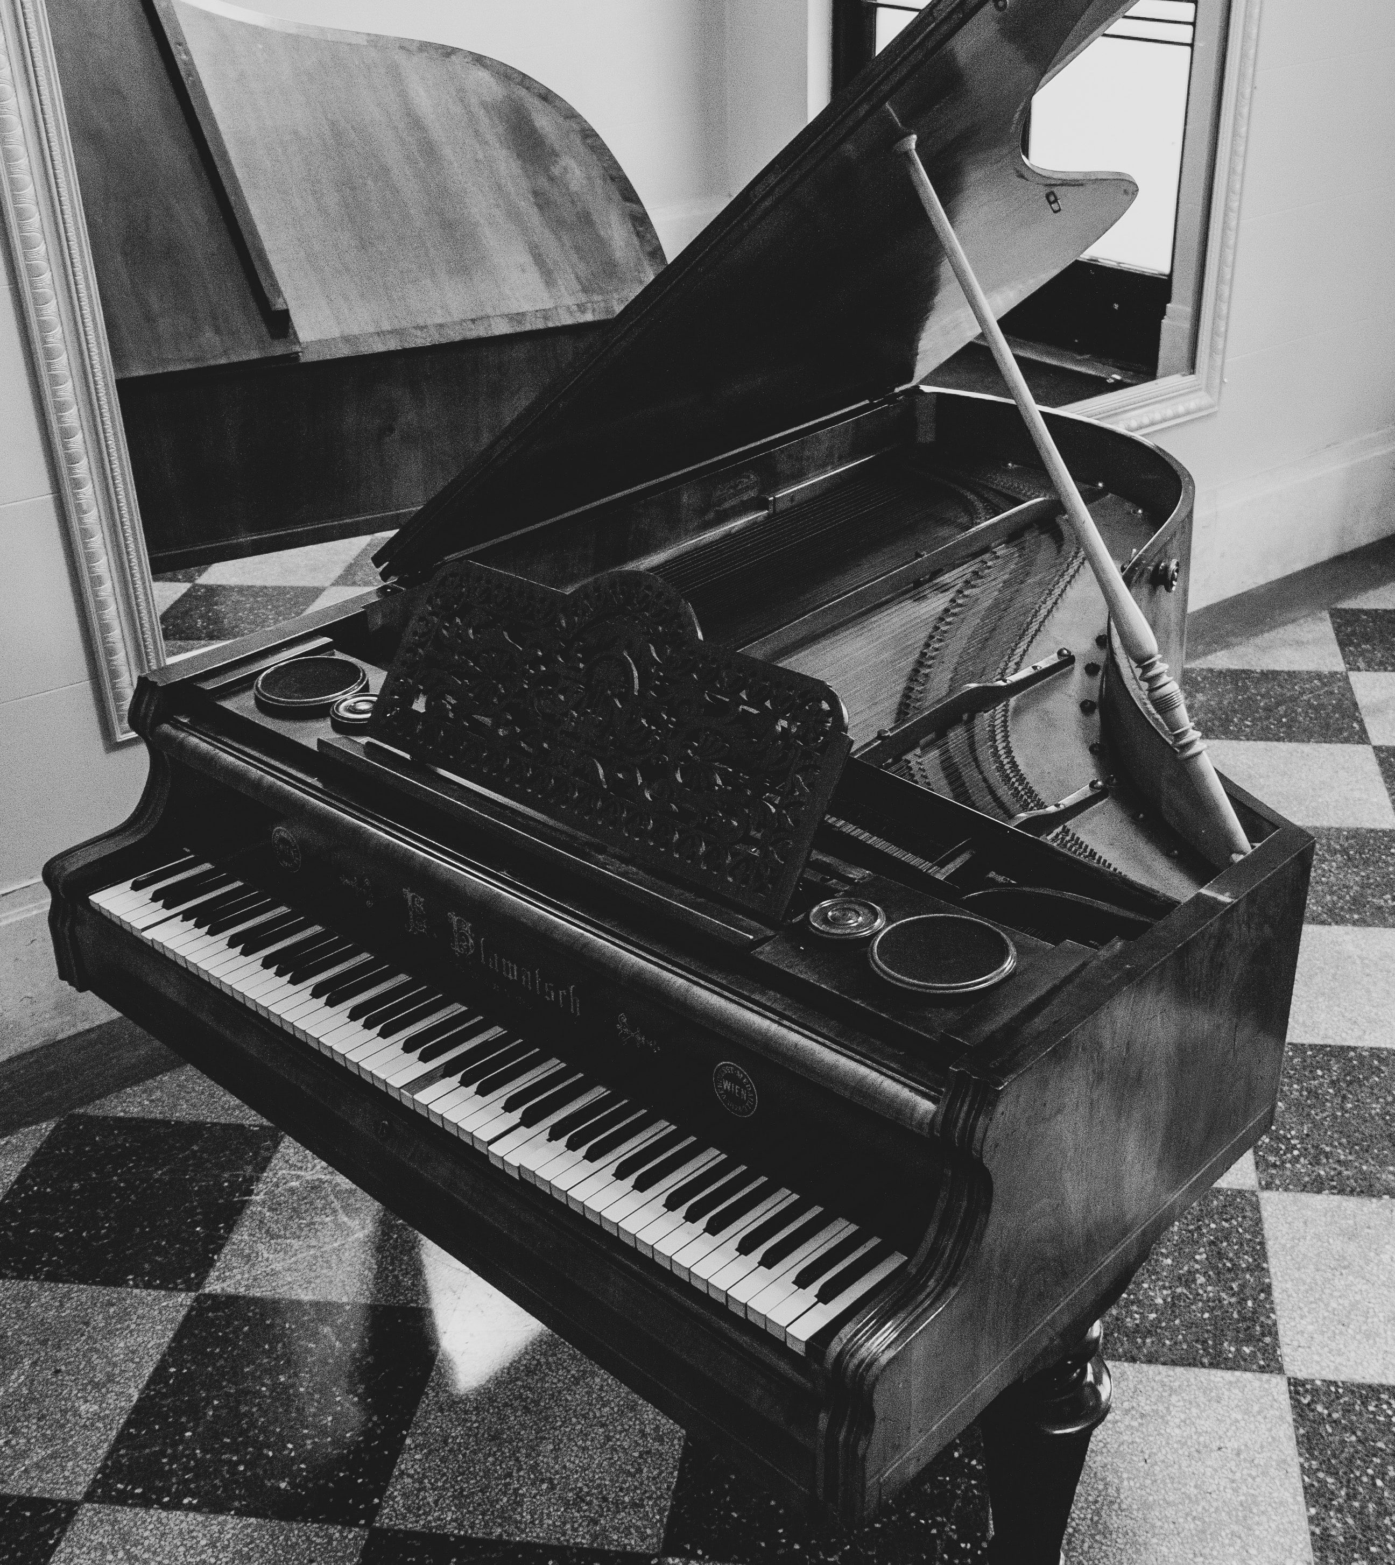
Commonsense Reasoning
Explaining counterfactual statements
Input:
Piano is a kind of sport. This is False because ___________________
Annotators 1 and 4:
you can produce music when pressing keys on the piano, so it is an instrument.
Annotators 3 and 5:
piano is a musical instrument used in songs to produce different musical tones.
Annotator 2:
piano is a kind of art form.

Slide 17
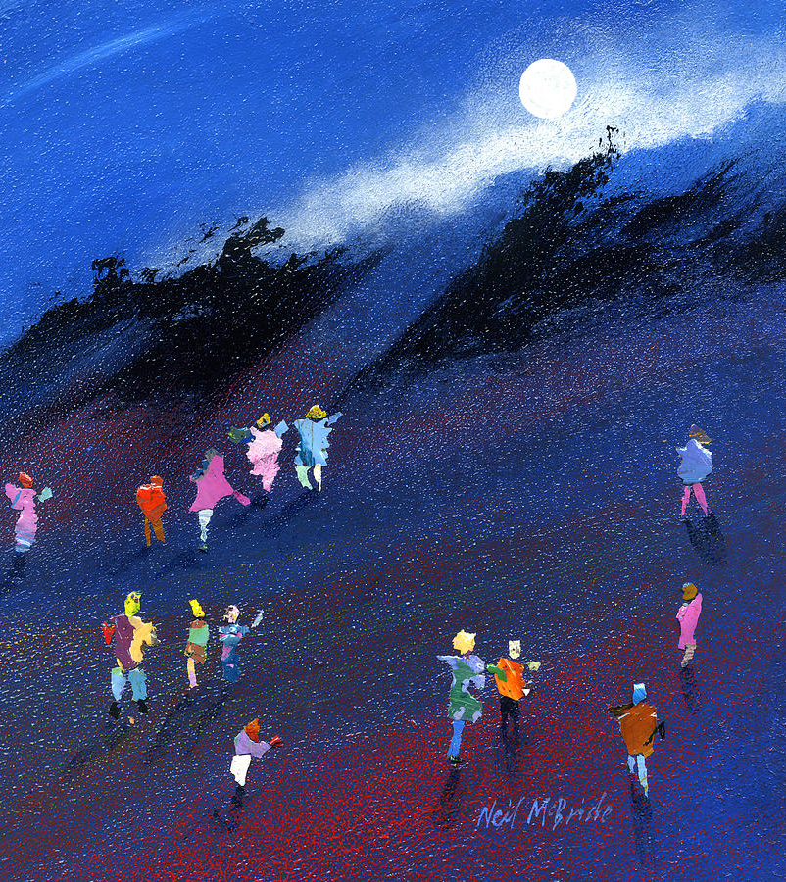

Beam Search with $p_{θ}(Y|X)$
Greedy algorithm
piano
is
a
an
not
musical
a
instrument
sport
.

Slide 18
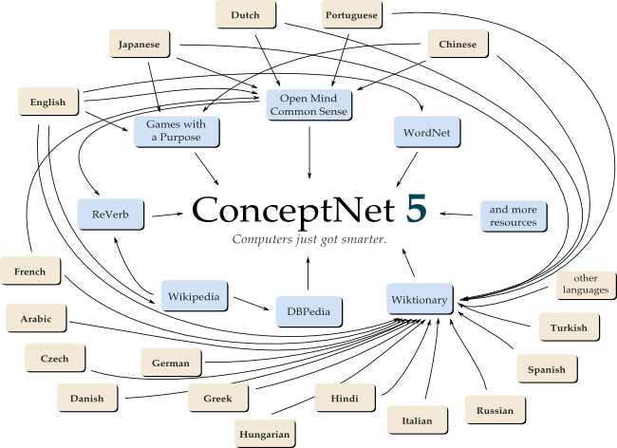
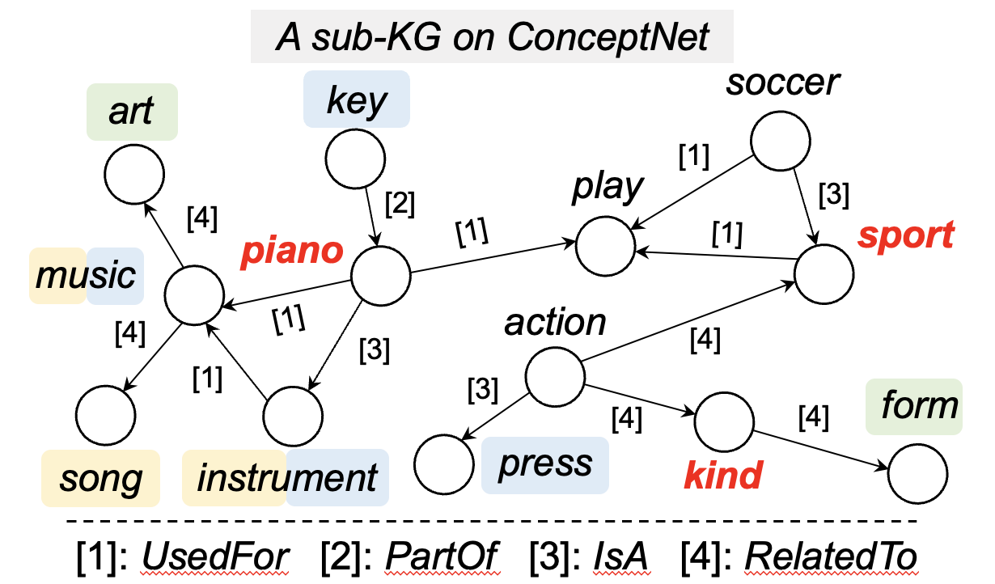
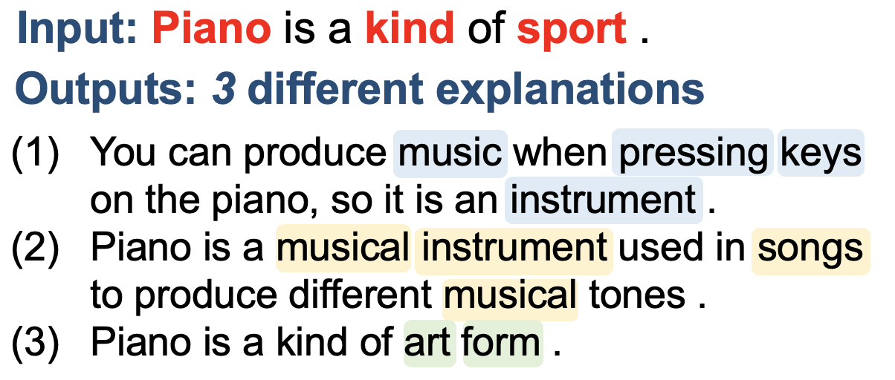
Enhancing GENERATION DIVERSITY

Slide 19
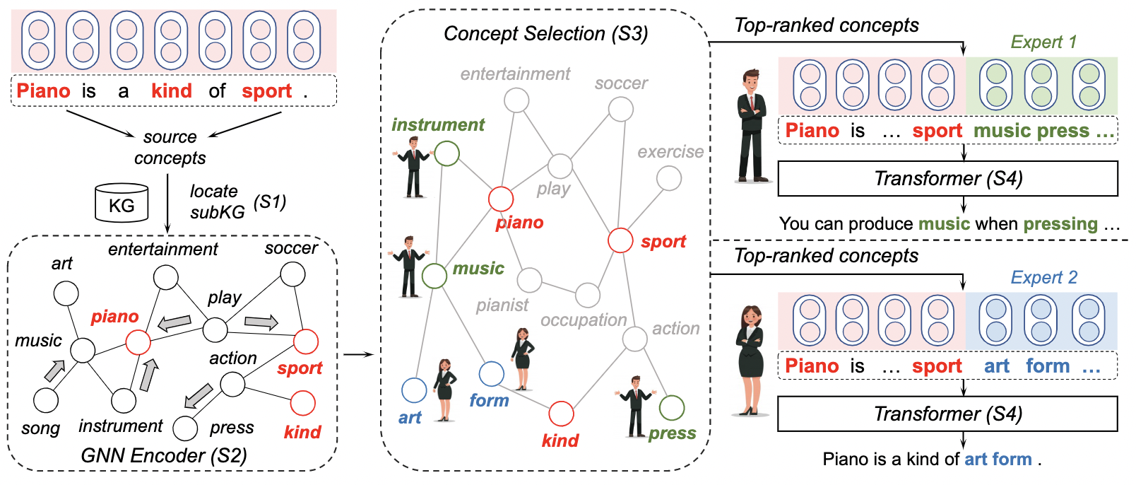
Mixture of Knowledge Graph Experts (MoKGE)
Accepted to ACL 2022 and DLG4NLP@NAACL 2022
Yu, Zhu, Qin, Zhao, Jiang. “Diversifying Content Generation for Commonsense Reasoning with Mixture of Knowledge Graph Experts.” In ACL, pp. 1896-1906. 2022.

Slide 20


Results: ComVE (SemEval 2020: Task 4)
 | SelfBERT (↓) | Distinct-2 (↑) | R-L (↑)
Truncated samp. | 61.39 | 34.80 | 17.48
Nucleus samp. | 63.43 | 34.17 | 17.68
MoKGE | 30.93 | 48.44 | 19.13
Human | 12.36 | 63.02 | 100.0
Human evaluation:
 | Diversity | Quality
Truncated samp. | 2.15±0.76 | 2.22±1.01
Nucleus samp. | 2.03±0.73 | 2.29±1.03
MoKGE | 2.63±0.51 | 2.10±0.99
Human | 2.60±0.59 | 3.00

Slide 21



Results: α-NLG (Abductive Commonsense Reasoning)
Cleaned house
Went to work
Leaved windows open
 | SelfBERT (↓) | Distinct-2 (↑) | R-L (↑)
Truncated samp. | 52.11 | 30.08 | 38.98
Nucleus samp. | 56.32 | 29.92 | 13.53
MoKGE | 27.40 | 38.15 | 38.82
Human | 10.36 | 53.57 | 100.0
?
Human evaluation:
 | Diversity | Quality
Truncated samp. | 2.31±0.76 | 2.63±0.77
Nucleus samp. | 2.39±0.73 | 2.67±0.72
MoKGE | 2.66±0.51 | 2.57±0.71
Human | 2.71±0.57 | 3.00
Back home
Found a mess

Slide 22

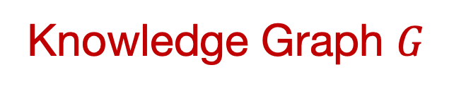
Precision ++
Factual Correctness ++
Input $X$
Machine Translation
Abstractive Summarization
Language Generation Model
$$p_{θ}(Y|X)$$
Knowledge Graph $G$
$$p_{θ}(Y|X,G)$$
Output $Y$
Accuracy ++
Diversity ++
Question Answering
Commonsense Reasoning

Slide 23
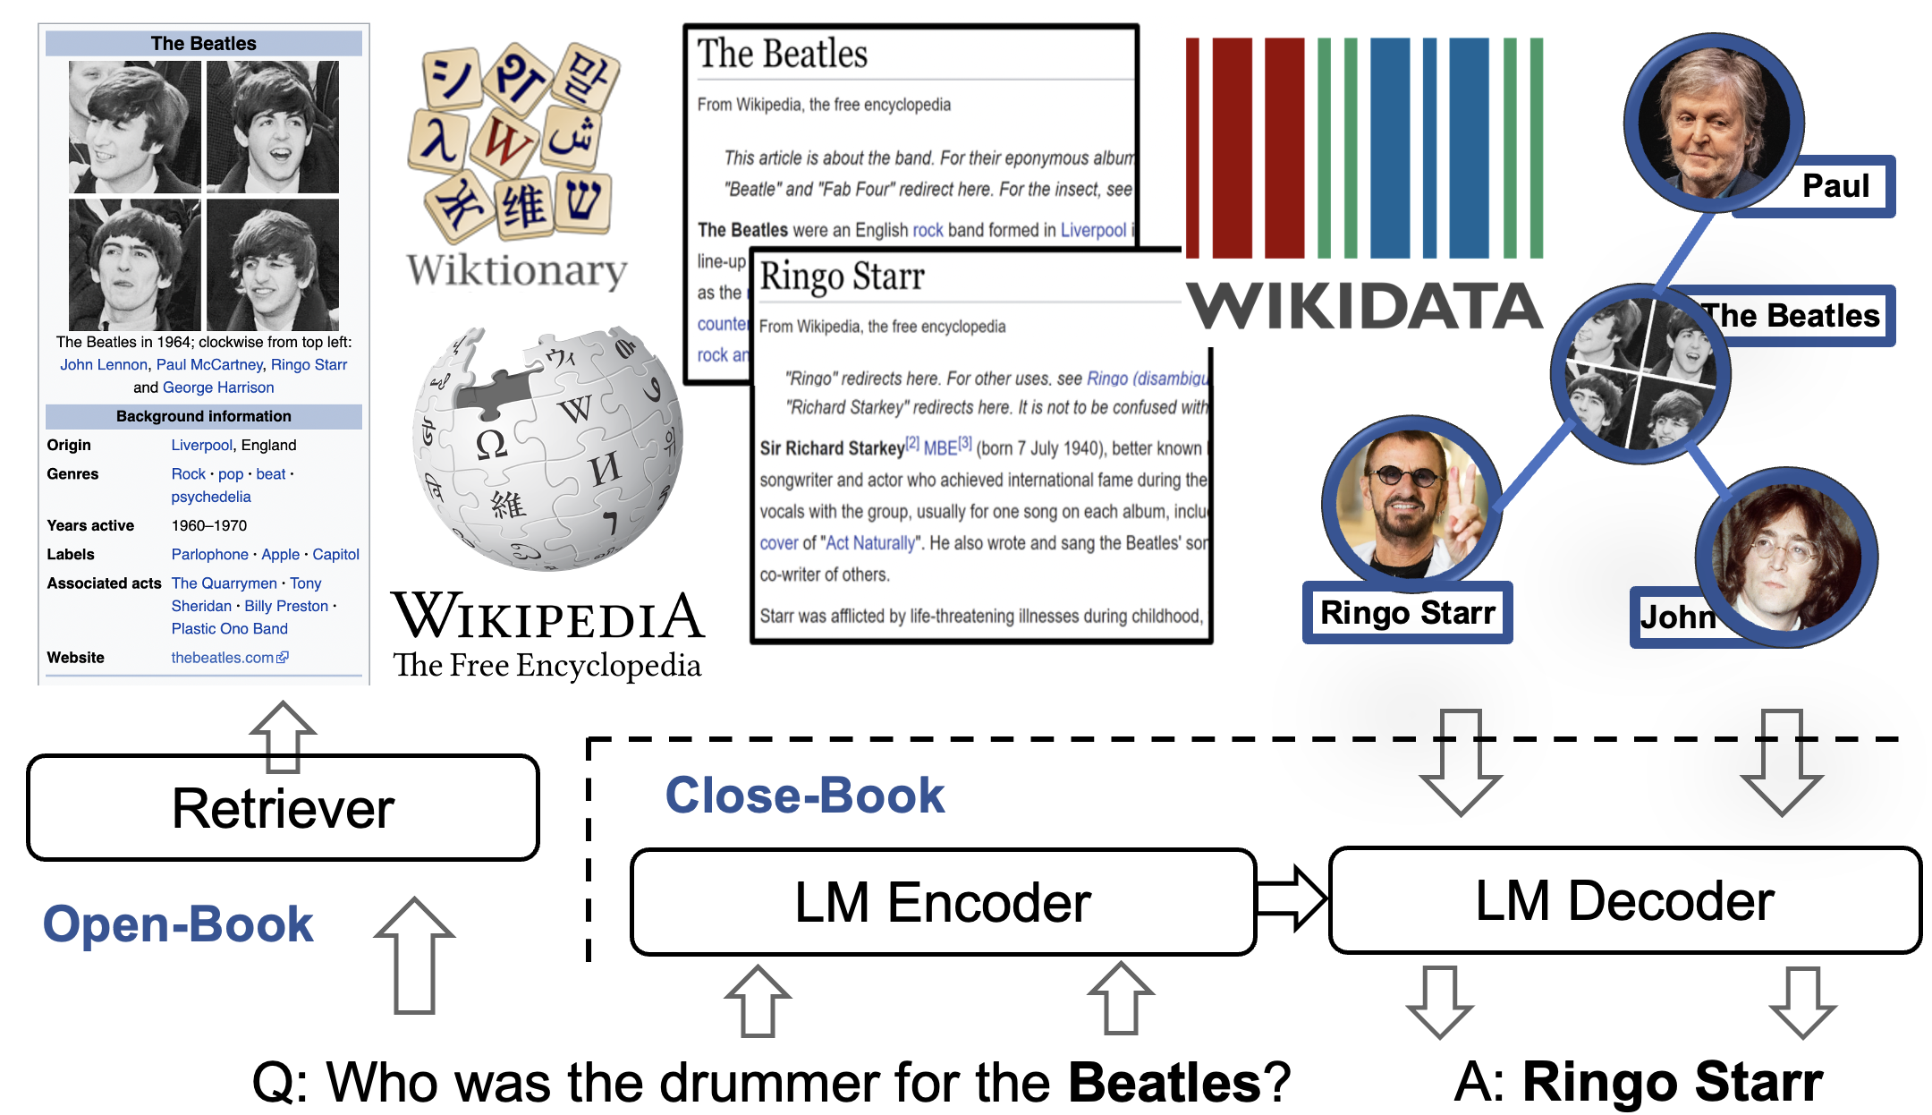
Enhancing QA ACCURACY
Open-book vs Close-book

Slide 24



A Unified Encoder-Decoder Framework with Entity Memory
Abu Dhabi
The 2022 Conference on Empirical Methods in Natural Language Processing
Zhihan Zhang, Wenhao Yu, Chenguang Zhu, Meng Jiang

Slide 25
Efficiency, Accuracy, and Generalizability
Book
Memory
[Févry, et al.
EMNLP 2020.]
DPR
Text
Entity
Embeddings
Input
Output
Input
Output
Input
Output
BART/
Linker
FiD
Linker
Closed-Book
Open-Book
Closed Book with Entity Memory (EaE)
 | Inference Time (TriviaQA) |  |  | Answer Prediction (EM) |  |  | Text Generation (R-L)
 | Index | Retrieval | Prediction | TriviaQA | NQ | WebQ | CREAK | MSMARCO | ELI5
BART | 0 | 0 | 18s | 25.02 | 24.82 | 29.23 | 30.34 | 53.26 | 22.99
Linker |  |  |  | 27.54 | 25.96 | 29.38 | × | × | ×
EaE | 0 | 0 | 20s | 41.01 | 25.54 | 38.88 | × | × | ×
Open-Book | 29min | 15min | 41min | 67.60 | 51.40 | 47.64 | - | - | -
Closed-Book
EaE | 0 | 0 | 20s | 41.01 | 25.54 | 38.88 | × | × | ×

Slide 26








EDMem: Encoder-Decoder with Memory
Enabling Efficient Question Answering and Text Generation
[Es] Down House [Ee]
$$ℒ$$
Pre-training the memory on
Entity linking (as EaE)
Random token masking (for language modeling)
Salient span masking (for text generation)
Advantages:
In QA (vs EaE): create both entity and non-entity answers
In text generation (vs BART): generating more entities without sacrificing fluency
Language Modeling Head
$$ℒ$$
$$H$$
Entity Linking Head
Transformer Encoder
Transformer Decoder
$$L_{2}×$$
$$L_{2}×$$
$$H$$
+
$$L_{1}×$$
+
Transformer Encoder
Transformer Decoder
$$H$$
$$L_{1}×$$
Entity Memory
Where did [Es] Charles Darwin [Ee] live?
[BOS] [Es] Down House

Slide 27
Insights on Knowledge-Augmented NLP
Efficient Augmentation with Memory
 | Inference Time (TriviaQA) |  |  | Answer Prediction (EM) |  |  | Text Generation (R-L)
 | Index | Retrieval | Prediction | TriviaQA | NQ | WebQ | CREAK | MSMARCO | ELI5
BART | 0 | 0 | 18s | 25.02 | 24.82 | 29.23 | 30.34 | 53.26 | 22.99
Linker |  |  |  | 27.54 | 25.96 | 29.38 | × | × | ×
EaE | 0 | 0 | 20s | 41.01 | 25.54 | 38.88 | × | × | ×
EDMem | 0 | 0 | 20s | 47.23 | 30.19 | 41.44 | 31.78 | 54.45 | 23.97
Open-Book | 29min | 15min | 41min | 67.60 | 51.40 | 47.64 | - | - | -
Unified approach is effective for QA and text generation tasks.
Pre-trained memory can efficiently augment predictors/decoders.
Find in the paper: Investigating entity-aware decoding strategies.

Slide 28



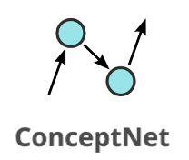



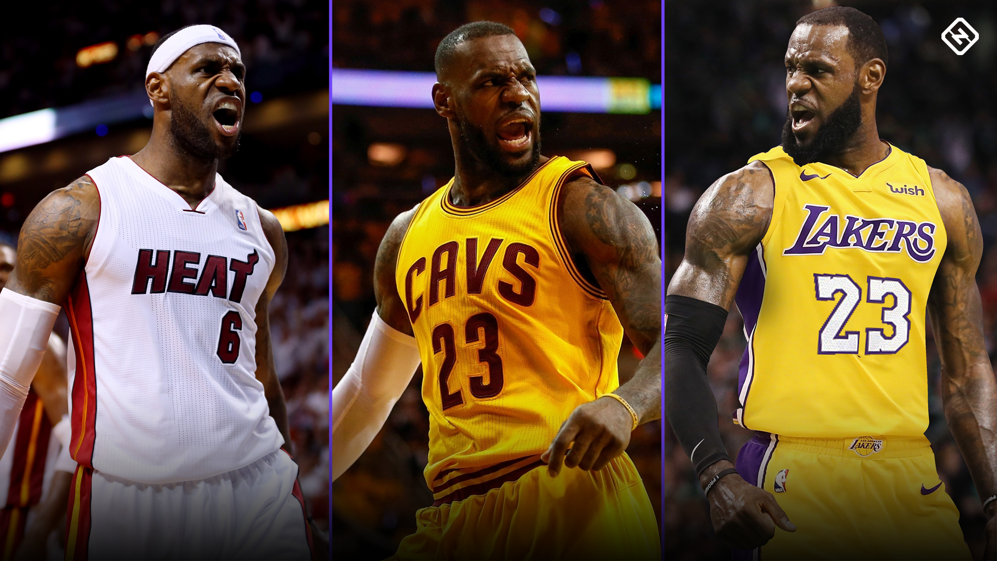



Heterogeneity
“Books”
Dynamics

Slide 29
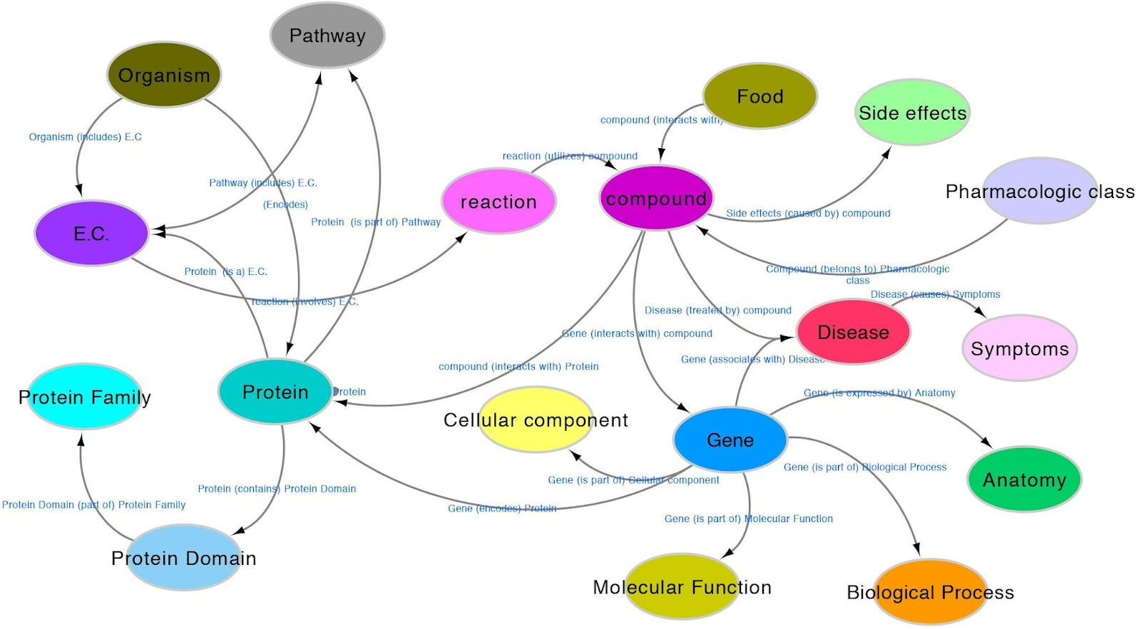
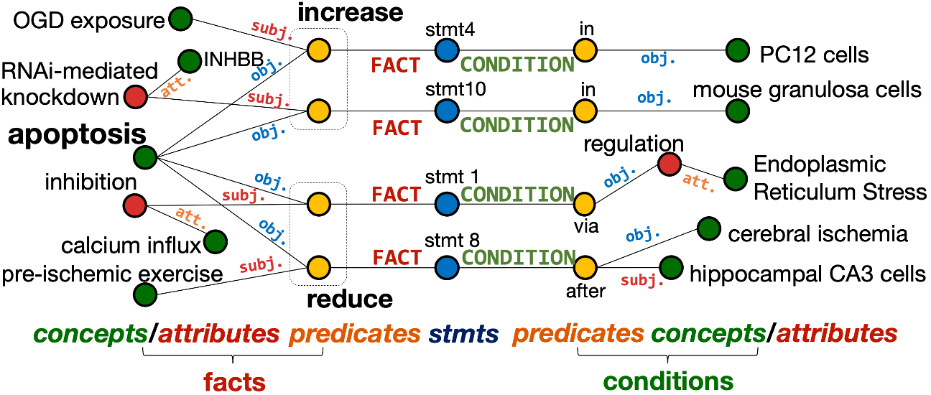
Science
Specialized
KGs
Q: … I‘ve lost contact with old friends, I don’t see them or speak to them for months on end. I am truly alone. I was kicked out of my old college because I never went to my lessons, and I’ve nearly been kicked out of my new one for the same reason, I just don’t want to do anything, and my family are disappointed in me for this, they want me to have a good future, when I don‘t seen myself having one I don’t see myself growing old and having a family with kids. I don‘t know what to do, ….
Never went to my lessons
Was kicked out of my old college
Nearly been kicked out of my new [college]
I just don’t want to do anything
My family are disappointed in me
Mental Health: r/SuicideWatch

Slide 30
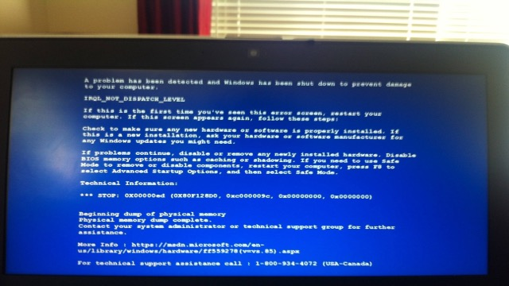







Technical Support
Online Education
Mental Health
Scientific Discovery
CAREER Award

Slide 31

Welcome to visit our lab!
http://www.meng-jiang.com/lab.html
https://github.com/DM2-ND
mjiang2@nd.edu

